Slide 1
Design and Simulation of a 32-bit RISC-V Core and APB
Md. Rafiqul Islam Rafi, 1706007
Sheikh Munim Hossain Shakib, 1706008
Abdullah Al Mahmood, 1706010
Md.Jahidul Hoq Emon, 1706017
Shafin Shadman, 1706020
Golam Mahmud Samdani, 1706029
Ayan Biswas Pranta, 1706032
Presented To: Dr. A.B.M Harun-ur-Rashid, Mumtahina Islam Sukanya, AKM Uday Hasan Bhuiyan and NSL Team
Course: EEE 468
Group: 3

Slide 2
Introduction
VLSI (Very large Scale Integration) is the process of embedding transistors on a single semiconductor chip. The best way to do it is to use programming codes. SystemVerilog is an important coding language that helps simulate lots of transistors in a single chip by means of codes.
Microprocessors can be of different architectures: Single-cycle, multi-cycle and pipelined. Multi-cycle architecture defines its input and output datapath and controls. SystemVerilog can be used to design multi-cycle architecture.
RISC-V is an open standard instruction set architecture based on RISC principles. It is free-for-all, and can be implemented easily by using SystemVerilog. RISC-V has its own way of defining instructions in assembly and machine languages. Codes are compiled in SystemVerilog according to RISC-V standards.
In this project, instructions have been compiled in RISC-V architecture using SystemVerilog.

Slide 3
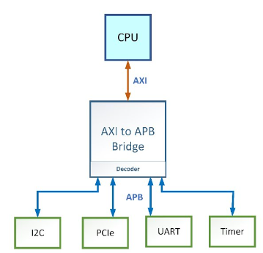
APB: Preface
APB or Advanced Peripheral Bus is a industry standard protocol that is used to communicate with peripheral components.
APB Bridge is the master
Peripherals are the slave
Write means master to slave communication
Read means slave to master communication
Separately passing address and data, much faster

Slide 4
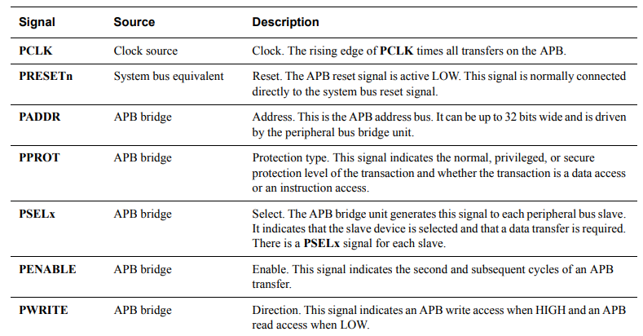
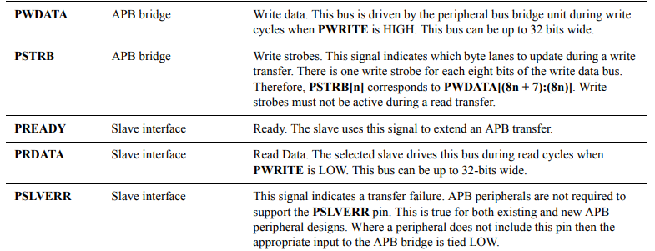
APB: Controlling Signals

Slide 5
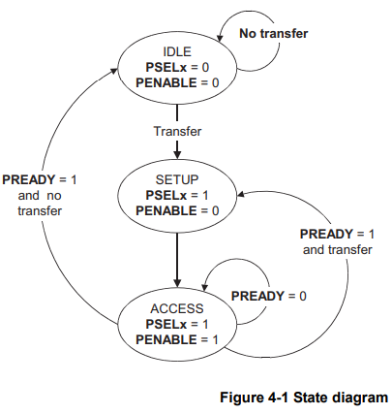
APB: State Diagram

Slide 6
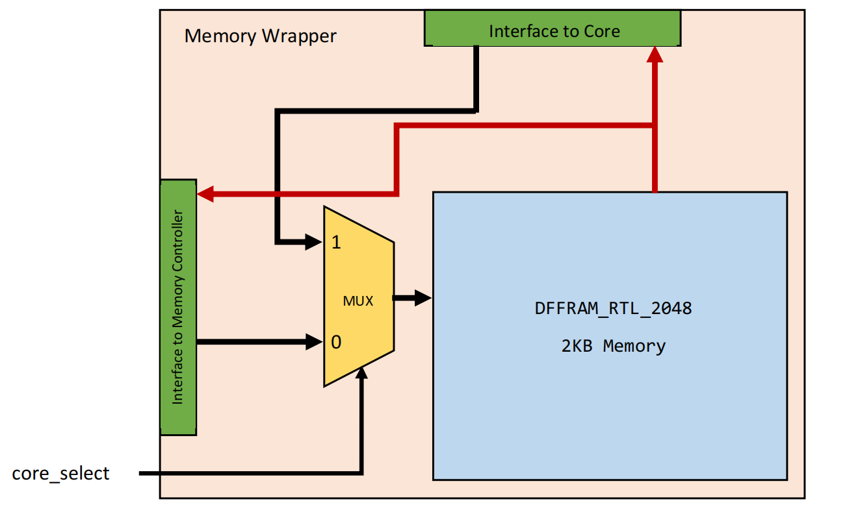
Memory Wrapper

Slide 7
ALU(Arithmetic Logic Unit)
clk enable
Arithmetic Logic Unit
Input: [31:0]a ,[31:0]b
[3:0]alucontrol
Output [31:0]result,[3:0]flags
[31:0]a
[31:0]result
[31:0]b
ALU
[3:0]flags
[3:0]alucontrol
Flags | Description
N | Set when the result of operation is negative
Z | Set when the result of operation is zero
C | Set when carry is generated
V | set when overflow occurs

Slide 8
ALU(Arithmetic Logic Unit Contd.)
Alucontrol | Operation
4’b0000 | Addition
4’b0001 | Subtraction
4’b0010 | And
4’b0011 | OR
4’b0100 | xor
4’b0101 | set less than
4’b0110 | shift left logical
4’b0111 | shift right logical
4’b1000 | shift right arithmetic

Slide 9

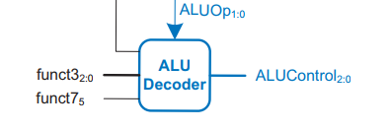
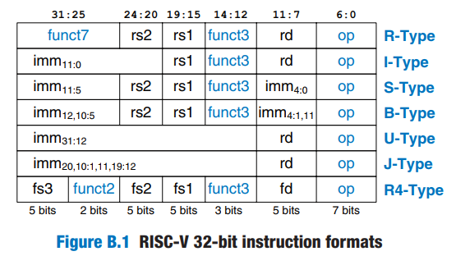
ALU(Arithmetic Logic Unit Contd.)
ALUOp | funct3 | Op_5*func7_5 | func7_b_5 | ALUControl | Instruction
00 | x | x | x | 4’b0000 | add
01 | x | x | x | 4’b0001 | subtract
10 | 3’b000 | 1 | x | 4’b0001 | subtract
 |  | 0 | x | 4’b0000 | add
 | 3’b001 | x | x | 4’b0110 | sll.slli
 | 3’b010 | x | x | 4’b0101 | slt,slti
 | 3’b100 | x | x | 4’b0100 | xor,xori
 | 3’b101 | x | 1 | 4’b1000 | sra,srai
 |  | x | 0 | 4’b0111 | srl,srli
 | 3’b110 | x | x | 4’b0011 | or,ori
 | 3’b111 | x | x | 4’b0010 | and,andi
Fig:ALUDecoder Block

Slide 10


Data Path Element(Non Architectural Register)
flopr #(32) datareg(clk, reset, ReadData, Data);
flopenr #(32) pcreg(clk, reset, PCWrite, Result, PC);
Here,PCWrite is the enable signal

Slide 11
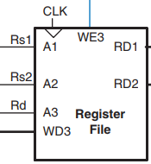
Data Path Element(Register)
regfile rf(
clk, reset,
RegWrite,
Instr[19:15],
Instr[24:20],
Instr[11:7],
Result,
RD1,
RD2);
Instr[19:15]
Instr[24:20]
Instr[11:7]

Slide 12

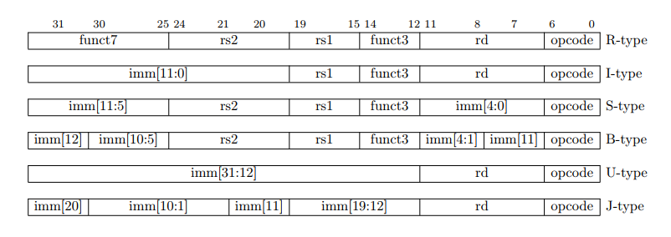
Data Path Element(Immediate Extender)
ImmSrc
extend ext(
Instr[31:7],
ImmSrc,
immext);
Instr

Slide 13
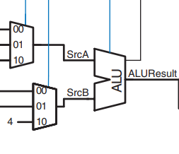
Data Path Element(ALU)
ALUControl[3:0]
flags
ALUSrcA[1:0]
ALUSrcB[1:0]
//ALU logic
mux3 #(32) srcamux(PC, OldPC, A, ALUSrcA, SrcA);
mux3 #(32) srcbmux(WriteData, immext, 32'd4, ALUSrcB, SrcB);
alu alu(SrcA, SrcB, alucontrol, ALUResult, Flags);
flopr #(32) aluoutreg(clk, reset, ALUResult, ALUOut);
mux3 #(32) resmux(ALUOut, Data, ALUResult, ResultSrc, Result);

Slide 14
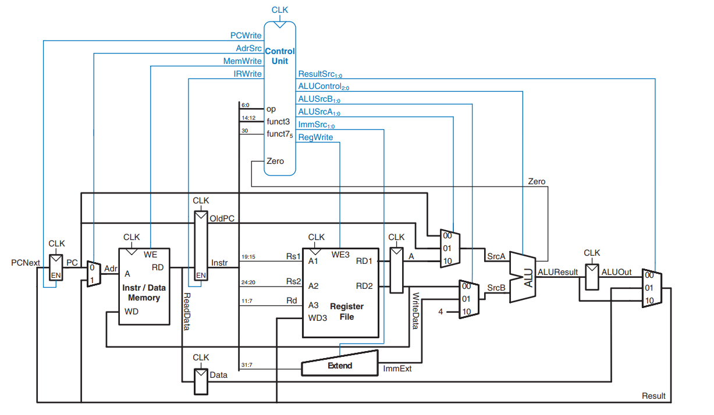
Data Path (Complete Multicycle)

Slide 15
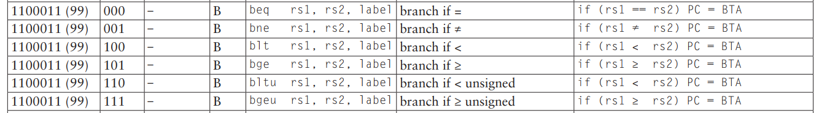
Branch Unit
funct3 | condition | operation
3’b000 | z | beq
3’b001 | ~z | bne
3’b100 | n^v | blt
3’b101 | ~(n^v) | bge
3’b110 | ~c | bltu
3’b111 | c | bgeu
funct3[2:0], Branch, [3:0] Flags
bu.sv
branchtaken
Reference:Digital Design and Computer Architecture_riscv edition by Sarah Harris and David Harris

Slide 16
Load/Store Unit
Load/Store
Input funct3[2:0]
Output LoadType, StoreType
lsu.sv
funct3[2:0]
LoadType, StoreType
Instruction | funct3 | LoadType/StoreType
Store | 000 | 01
Neither | 010 | 00
Load | 100 | 1x

Slide 17
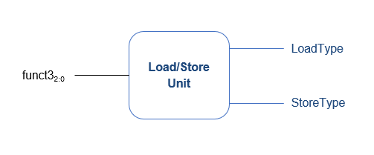
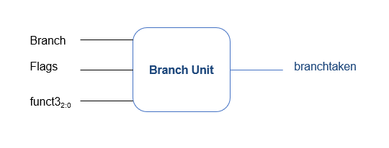
Controller
CLK
RESET
mem_data_length[1:0]
mem_en
PCTargetSrc
ImmSrc[2:0]
ALUSrcA[1:0]
ALUSrcB[1:0]
ResultSrc[1:0]
funct7b5
AdrSrc
Controller
IRWrite
[6:0] op
PCUpdate
[2:0] funct3
RegWrite
MemWrite
[3:0] Flags
ALUOp[1:0]
Branch
ALUControl[3:0]
PCWrite
LoadType
StoreType

Slide 18
Controller
module controller(
input logic clk,
input logic reset,
input logic [6:0] op,
input logic [2:0] funct3,
input logic funct7b5,
input logic [3:0] Flags,
output logic [2:0] ImmSrc,
output logic [1:0] ALUSrcA, ALUSrcB,
output logic [1:0] ResultSrc,
output logic AdrSrc,
output logic [3:0] ALUControl,
output logic IRWrite, PCWrite,
output logic RegWrite, MemWrite,
output logic LoadType, // lbu
output logic StoreType, // sb
output logic PCTargetSrc, // jalr
output logic mem_en,
output logic [1:0] mem_data_length);
logic [1:0] ALUOp;
logic Branch, PCUpdate;
logic branchtaken; // added for other branches
// Main FSM
mainfsm fsm(
clk,
reset,
op,
ALUSrcA,
ALUSrcB,
ResultSrc,
AdrSrc,
IRWrite,
PCUpdate,
RegWrite,
MemWrite,
ALUOp,
Branch);
// ALU Decoder
aludec ad(
op[5],
funct3,
funct7b5,
ALUOp,
ALUControl);
// Instruction Decoder
instrdec id(
op,
ImmSrc);
// Load, Store, Branch logic
lsu lsu(
funct3,
LoadType,
StoreType);
bu branchunit(
Branch,
Flags,
funct3,
branchtaken); // added for bne, blt, etc.
assign PCWrite = branchtaken | PCUpdate;
// Mem_en and Mem_data_length signal inclusion for memory wrapper input
assign mem_en = MemWrite | !MemWrite;
assign mem_data_length = 2'b00; // lsuctrl -> load-store control has been removed and always will be read in 32 bits
endmodule

Slide 19
List of Instructions Used
auipc
addi
add
jal
sw
lw
beq
bne
sub
bge
blt
bltu
bgeu
jalr
ori
andi
xori
slli
srli
srai
slti
sltiu
or
and
xor
slt
sltu

Slide 20
Instruction Decoder
Instruction decoding
Input op[6:0]
Output immsrc[2:0]
instrdec.sv
op[6:0]
ImmSrc [2:0]
Instruction | Op Code | ImmSrc
R-type | 0110011 | xxx
I-Type ALU | 0010011 | 000
lw | 0000011 | 000
sw | 0100011 | 001
be (branches) | 1100011 | 010
jal | 1101111 | 011
jalr | 1100111 | 000
auipc | 001011 | 100

Slide 21
Instruction Decoder
module instrdec (
input logic [6:0] op,
output logic [2:0] ImmSrc);
always_comb begin
case(op)
7'b0110011: ImmSrc = 3'bxxx; // R-type
7'b0010011: ImmSrc = 3'b000; // I-type ALU
7'b0000011: ImmSrc = 3'b000; // lw / lbu
7'b0100011: ImmSrc = 3'b001; // sw / sb
7'b1100011: ImmSrc = 3'b010; // branches
7'b1101111: ImmSrc = 3'b011; // jal
// 7'b0110111: ImmSrc = 3'b100; // lui
7'b1100111: ImmSrc = 3'b000; // jalr
7'b0010111: ImmSrc = 3'b100; // auipc
default: ImmSrc = 3'bxxx; // ???
endcase
end
endmodule
Instruction decoding
Input op[6:0]
Output immsrc[2:0]

Slide 22
Immediate Extend File
Immediate extend verilog file
Input instr[31:7] & immsrc[2:0]
Output immext [31:0]
instr[31:7]
extend.v
reg immext [31:0]
immsrc [2:0]
ImmSrc | ImmExt | Type | Description
000 | {{20{instr[31]}}, instr[31:20]} | I | 12-bit signed immediate
001 | {{20{instr[31]}}, instr[31:25], instr[11:7]} | S | 12-bit signed immediate
010 | {{20{instr[31]}}, instr[7], instr[30:25], instr[11:8], 1'b0} | B | 13-bit signed immediate
011 | {{12{instr[31]}}, instr[19:12], instr[20], instr[30:21], 1'b0} | J | 21-bit signed immediate
100 | {instr[31:12], 12'b0} | U | 20-bit upper immediate to PC

Slide 23
Immediate Extend File
module extend(
input [31:7] instr,
input [2:0] immsrc,
output reg [31:0] immext);
always @(*) begin
case(immsrc)
// I-type
3'b000: immext = {{20{instr[31]}}, instr[31:20]};
// S-type (stores)
3'b001: immext = {{20{instr[31]}}, instr[31:25], instr[11:7]};
// B-type (branches)
3'b010: immext = {{20{instr[31]}}, instr[7], instr[30:25], instr[11:8], 1'b0};
// J-type (jal)
3'b011: immext = {{12{instr[31]}}, instr[19:12], instr[20], instr[30:21], 1'b0};
// U-type (auipc)
3'b100: immext = {instr[31:12], 12'b0};
default: immext = 32'bx; // undefined
endcase
end
endmodule
Extends the immediate value from the instruction according to the table using-
instr[31:7]
immsrc[2:0]

Slide 24
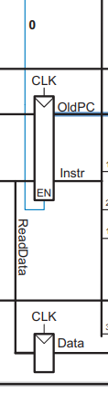
Flip-Flop: With and Without Enable
module flopenr #(parameter WIDTH = 8)(
input clk, reset, en,
input [WIDTH-1:0] d,
output reg [WIDTH-1:0] q);
always @(posedge clk, negedge reset) begin
if (!reset) q <= 0;
else if (en) q <= d;
end
endmodule
CLK
EN
We have both types of flip-flops ion our multicycle datapath The verilog files are-
flopenr
flopr
module flopr #(parameter WIDTH = 8)(
input clk, reset,
input [WIDTH-1:0] d,
output reg [WIDTH-1:0] q);
always @(posedge clk, negedge reset) begin
if (!reset)
q <= 0;
else
q <= d;
end
endmodule
CLK

Slide 25
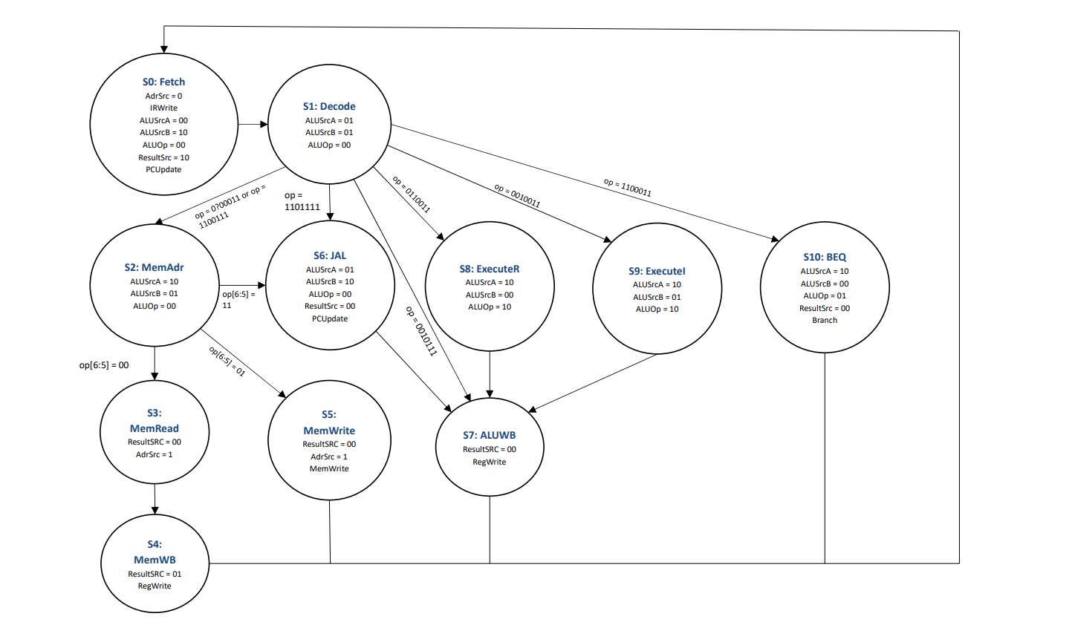
Main FSM

Slide 26
Main FSM
State | Controls
FETCH | 00_10_10_0_1100_00_0
DECODE | 01_01_00_0_0000_00_0
MEMADR | 10_01_00_0_0000_00_0
MEMREAD | 00_00_00_1_0000_00_0
MEMWRITE | 00_00_00_1_0001_00_0
MEMWB | 00_00_01_0_0010_00_0
EXECUTER | 10_00_00_0_0000_10_0
EXECUTEI | 10_01_00_0_0000_10_0
ALUWB | 00_00_00_0_0010_00_0
BEQ | 10_00_00_0_0000_01_1
JAL | 01_10_00_0_0100_00_0
CLK
RESET
ALUSrcA[1:0]
ALUSrcB[1:0]
ResultSrc[1:0]
AdrSrc
Main
FSM
IRWrite
[6:0] op
PCUpdate
RegWrite
MemWrite
ALUOp[1:0]
Branch

Slide 27
Main FSM
module mainfsm(
input logic clk,
input logic reset,
input logic [6:0] op,
output logic [1:0] ALUSrcA, ALUSrcB,
output logic [1:0] ResultSrc,
output logic AdrSrc,
output logic IRWrite, PCUpdate,
output logic RegWrite, MemWrite,
output logic [1:0] ALUOp,
output logic Branch);
typedef enum logic [3:0] {
FETCH, DECODE, MEMADR, MEMREAD,
MEMWB, MEMWRITE,
EXECUTER, EXECUTEI, ALUWB,
BEQ, JAL, UNKNOWN
} statetype;
statetype state, nextstate;
logic [14:0] controls;
// state register
always @(posedge clk or negedge reset) begin
if (!reset)
state <= FETCH;
else
state <= nextstate;
end
// next state logic
always @(*) begin
case(state)
FETCH: nextstate = DECODE;
DECODE: casez(op)
7'b0?00011: nextstate = MEMADR; // lw or sw
7'b0110011: nextstate = EXECUTER; // R-type
7'b0010011: nextstate = EXECUTEI; // addi
7'b1100011: nextstate = BEQ; // BEQ
7'b1101111: nextstate = JAL; // jal
7'b1100111: nextstate = MEMADR; //jalr
7'b0010111: nextstate = ALUWB; // aupic-> decode to aluwb
default: nextstate = UNKNOWN;
endcase
MEMADR: begin
casez(op[6:5])
2'b00: nextstate = MEMREAD; //memread
2'b01: nextstate = MEMWRITE; //memwrite
2'b11: nextstate = JAL; // jalr-> mem_add to JAL
endcase
end
MEMREAD: nextstate = MEMWB;
EXECUTER: nextstate = ALUWB;
EXECUTEI: nextstate = ALUWB;
JAL: nextstate = ALUWB;
default: nextstate = FETCH;
endcase
end
// state-dependent output logic
always @(*) begin
case(state)
FETCH: controls = 15'b00_10_10_0_1100_00_0;
DECODE: controls = 15'b01_01_00_0_0000_00_0;
MEMADR: controls = 15'b10_01_00_0_0000_00_0;
MEMREAD: controls = 15'b00_00_00_1_0000_00_0;
MEMWRITE: controls = 15'b00_00_00_1_0001_00_0;
MEMWB: controls = 15'b00_00_01_0_0010_00_0;
EXECUTER: controls = 15'b10_00_00_0_0000_10_0;
EXECUTEI: controls = 15'b10_01_00_0_0000_10_0;
ALUWB: controls = 15'b00_00_00_0_0010_00_0;
BEQ: controls = 15'b10_00_00_0_0000_01_1;
JAL: controls = 15'b01_10_00_0_0100_00_0;
default: controls = 15'bxx_xx_xx_x_xxxx_xx_x;
endcase
end
assign {ALUSrcA, ALUSrcB, ResultSrc, AdrSrc, IRWrite, PCUpdate,RegWrite,MemWrite, ALUOp, Branch} = controls;
endmodule

Slide 28
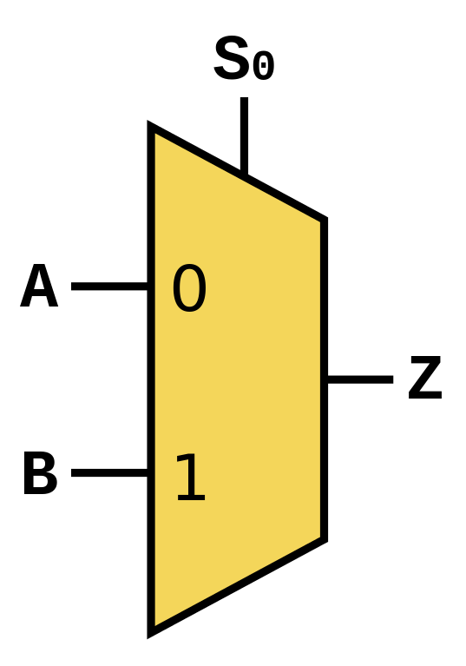
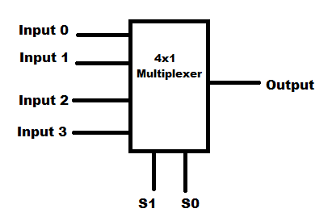
Multiplexers
Different types of multiplexers have been used to implement this project.
Control Pins | Output
00 | Input 0
01 | Input 1
10 | Input 2
11 | Input 3
Control Pin | Output
0 | A
1 | B

Slide 29
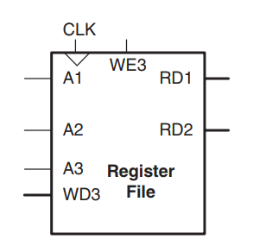
Register File
It basically reads the address of different instructions.
For our code , Outputs are RD1 , RD2.
32 bits , 32 registers have been used here.
When write enable(WE3) is active, data is written to register file.
Otherwise,data are read.
/module regfile(
input clk, reset,
input we3,
input [ 4:0] a1, a2, a3,
input [31:0] wd3,
output reg [31:0] rd1, rd2);
wire [31:0] rf[31:0];
always @(posedge clk, negedge reset) begin
if(!reset)
for (integer i=0; i<32; i=i+1)
rf[i] = 32'b0;
else if(we3)
rf[a3] <= wd3;
end
assign rd1 = (a1 != 0) ? rf[a1] : 0;
assign rd2 = (a2 != 0) ? rf[a2] : 0;
endmodule

Slide 30
Zero Extend
The first 24 bits are put as zero for the sake of zero extension of immediates.
When register,immediates are of different sizes, we have to match them using extension.
module zeroextend(
input logic [7:0] a,
output logic [31:0] zeroimmext);
assign zeroimmext = {24'b0, a};
endmodule

Slide 31
RISC V Primary Core
Now if we connect datapath and controller together, we get connection of our desired core.
module riscvmulti(
input logic clk, reset,
output logic MemWrite,
output logic [31:0] Adr, WriteData,
output logic mem_en,
output logic [1:0] mem_data_length,
input logic [31:0] ReadData);
logic RegWrite, jump;
logic [1:0] ResultSrc;
logic [2:0] ImmSrc;
logic [3:0] ALUControl;
logic PCWrite;
logic IRWrite;
logic [1:0] ALUSrcA;
logic [1:0] ALUSrcB;
logic AdrSrc;
logic [3:0] Flags;
logic [6:0] op;
logic [2:0] funct3;
logic funct7b5;
logic LoadType; // added for lbu
logic StoreType; // added for sb
logic PCTargetSrc; // added for jalr
controller c(
clk,
reset,
op,
funct3,
funct7b5,
Flags,
ImmSrc,
ALUSrcA,
ALUSrcB,
ResultSrc,
AdrSrc,
ALUControl,
IRWrite,
PCWrite,
RegWrite,
MemWrite,
LoadType,
StoreType, // lbu, sb
PCTargetSrc,
mem_data_length); // jalr
logic StoreType; // added for sb
logic PCTargetSrc; // added for jalr
controller c(
clk,
reset,
op,
funct3,
funct7b5,
Flags,
ImmSrc,
ALUSrcA,
ALUSrcB,
ResultSrc,
AdrSrc,
ALUControl,
IRWrite,
PCWrite,
RegWrite,
MemWrite,
LoadType,
StoreType, // lbu, sb
PCTargetSrc,
mem_data_length); // jalr

Slide 32
Connecting The Memory
wire core_reset_n;
assign core_reset_n = core_select & rst_n;
assign from_core_to_imem_rd_en_wire = !from_core_to_imem_wr_en_wire;
riscvmulti riscvmulti(
.clk(clk),
.reset(core_reset_n),
.MemWrite(from_core_to_imem_wr_en_wire),
.Adr(from_core_to_imem_address_wire),
.WriteData(from_core_to_imem_data_in_wire),
.mem_en(from_core_to_imem_en_wire),
.mem_data_length(from_core_to_imem_data_length_wire),
.ReadData(from_imem_to_core_data_wire)
);
When core is selected, work is done in core.
When core is not selected,work is done in memory.
core_select | Functionality
0 | Memory controller interface will be active.
1 | Core will start to work.

Slide 33
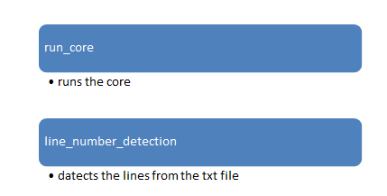
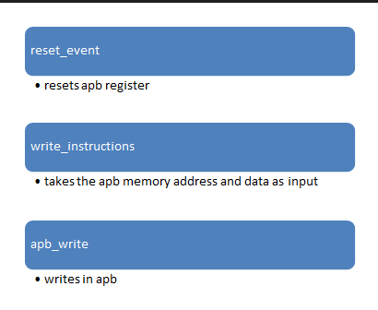
top_tb
The task performed in this module

Slide 34
apb_write & run_core
While writing in apb, the control pins are set like following
pselect = 1'b1;
pwrite = 1'b1;
pready = 1'b1;
And when apb write is done, pselect is set to 0 again, which is its default condition
In run_core
core_select = 1'b1
rst_n = 1'b1
both needs to be set to 1 to run the core

Slide 35
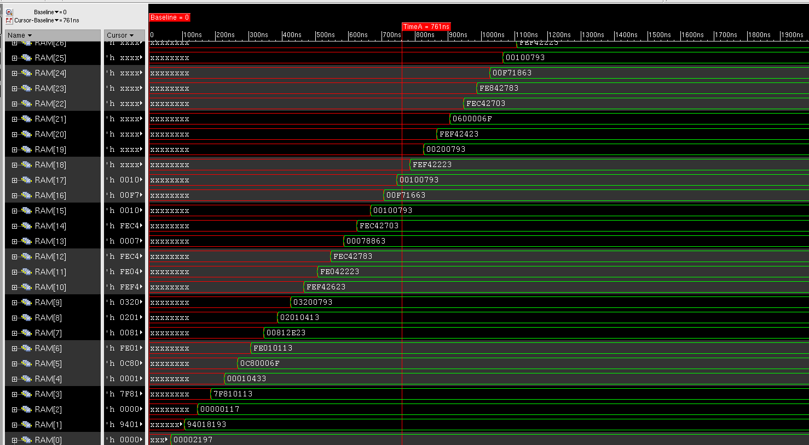
Analogy of Given Code: Instruction Loading in RAM Memory

Slide 36
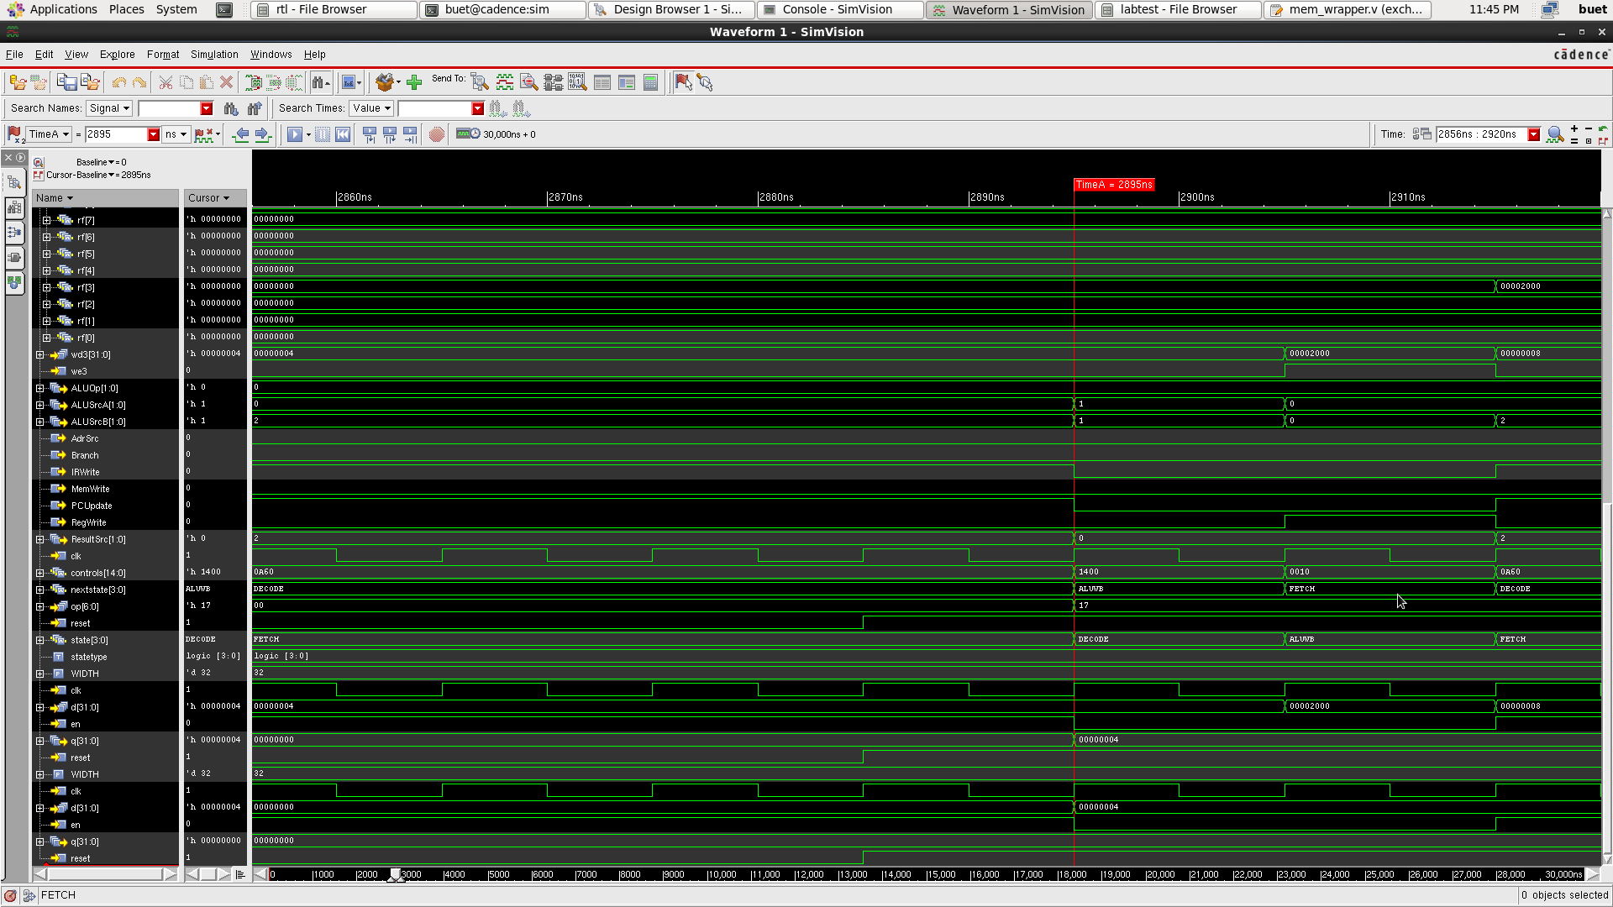
Analogy of Given Code: Instruction Loading in RAM Memory (Contd..)

Slide 37
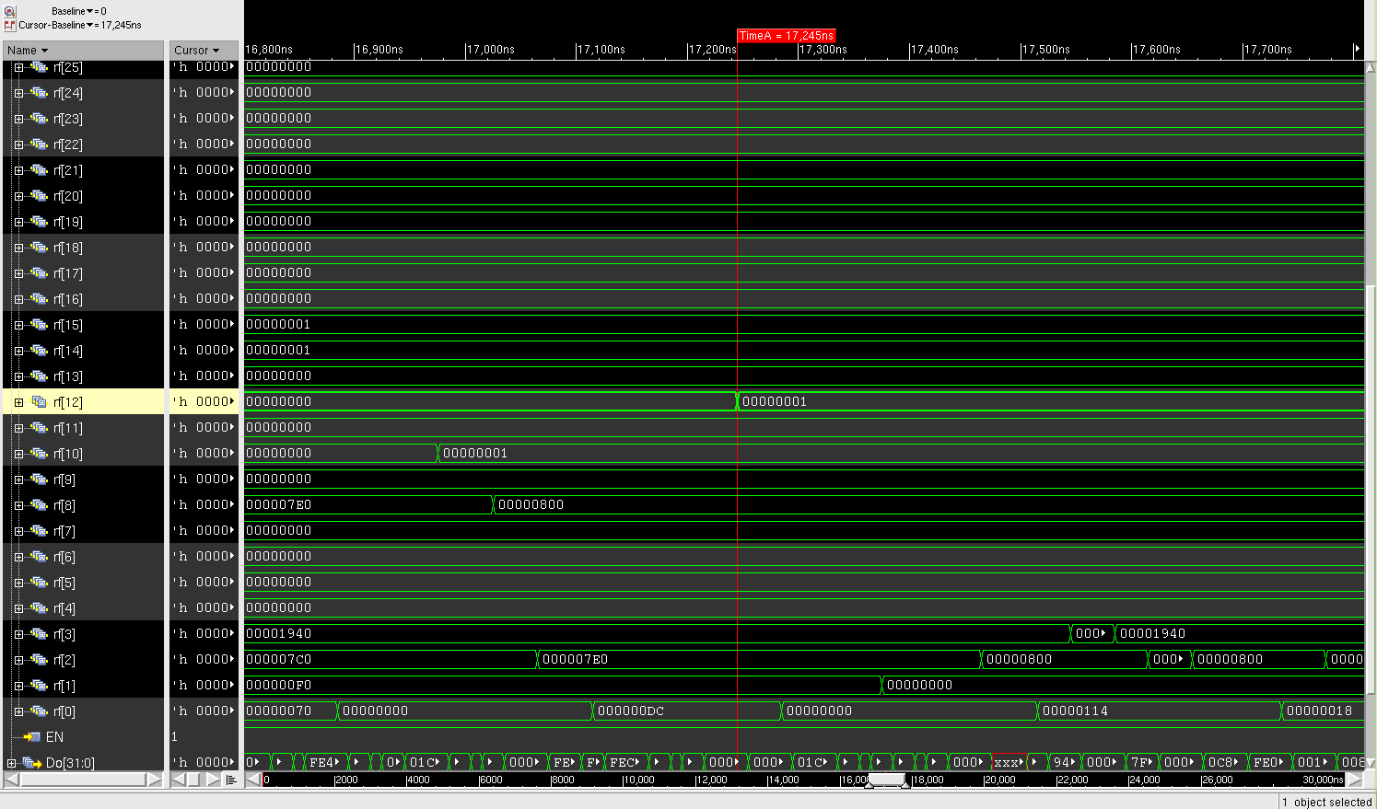
Analogy of Given Code: Time to Reach r[12]=1 point

Slide 38
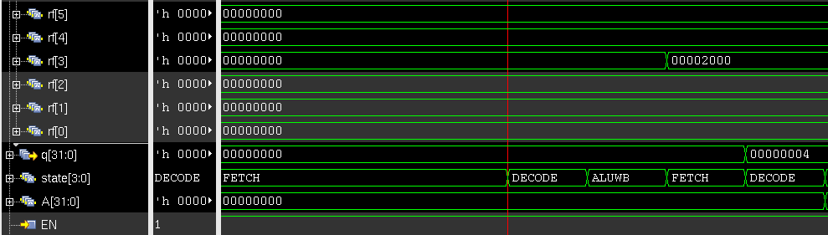
Analogy of Given Code: Different Instruction Description
0: auipc gp, 0x2
gp means register file’s 4th register

Slide 39
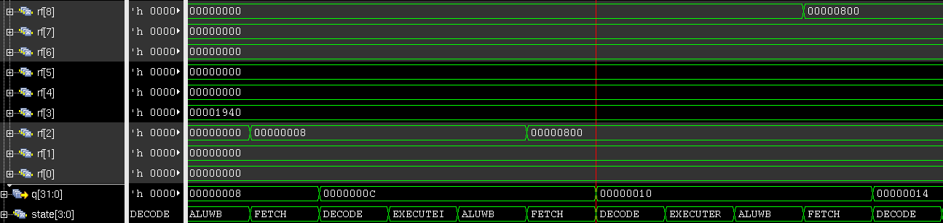
Analogy of Given Code: Different Instruction Description (Contd..)
s0 is 9th Register
sp is 3rd Register
zero is 1st Register
10: add s0, sp, zero

Slide 40
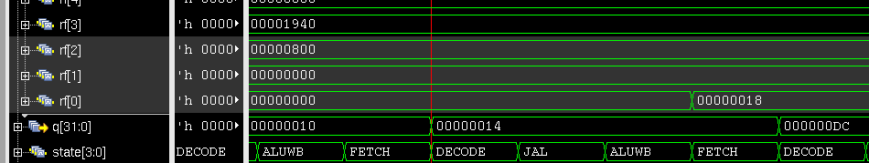
Analogy of Given Code: Different Instruction Description (Contd..)
14: j dc <main>

Slide 41
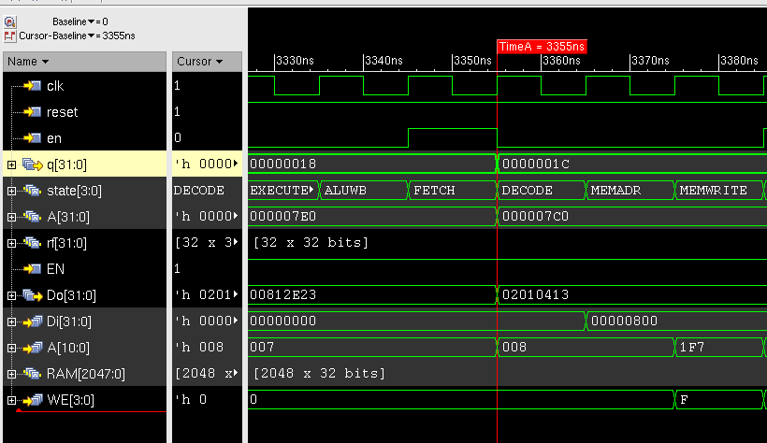
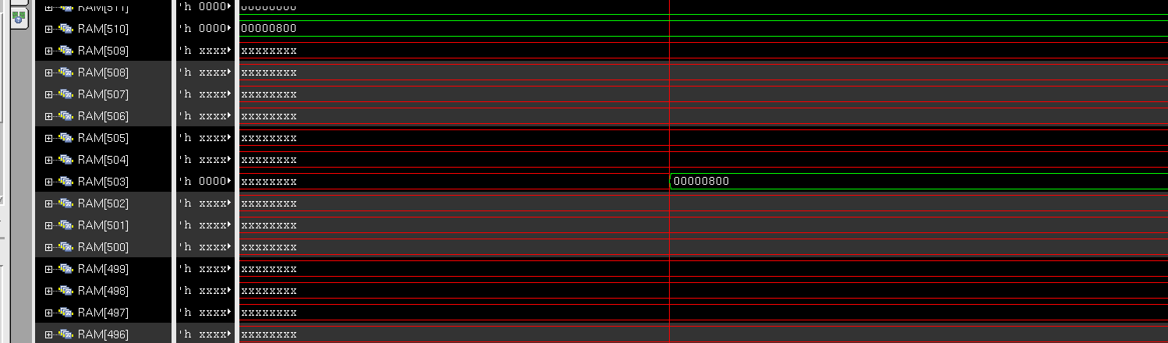
Analogy of Given Code: Different Instruction Description (Contd..)
1c: sw s0, 28(sp)
s0 is 9th Register
sp is 3rd Register

Slide 42
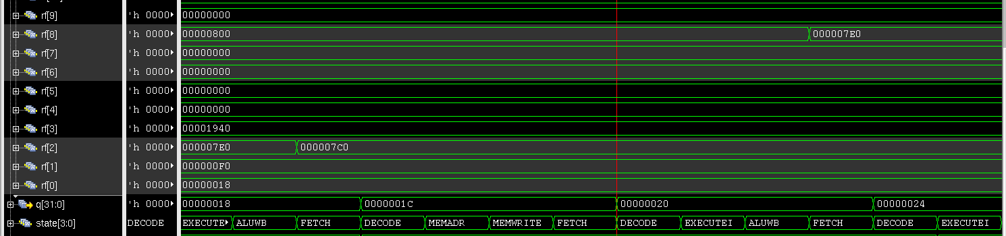
Analogy of Given Code: Different Instruction Description (Contd..)
20: addi s0, sp, 32
s0 is 9th Register
sp is 3rd Register

Slide 43
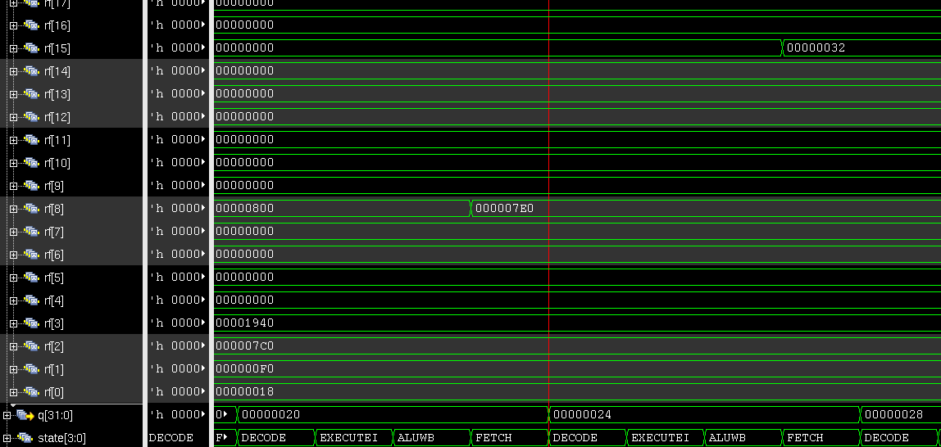
Analogy of Given Code: Different Instruction Description (Contd..)
24: li a5, 50
a5 is 16th Register

Slide 44
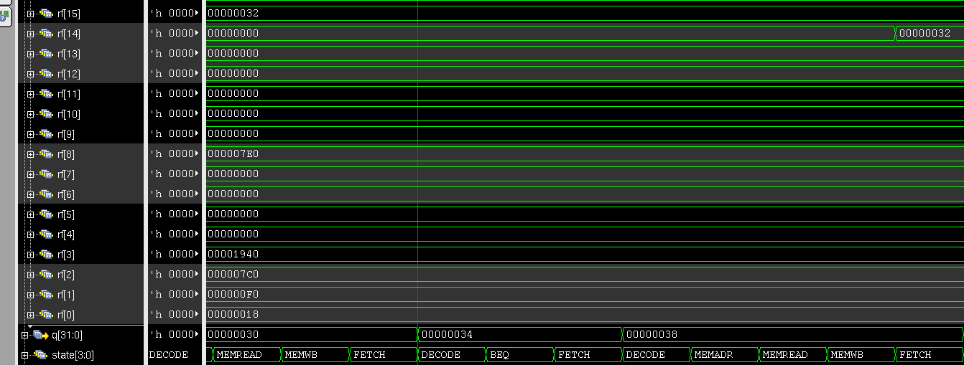
Analogy of Given Code: Different Instruction Description (Contd..)
34: beqz a5,44 <prime_number+0x2c>
Example of Branch not Taken
a5 is 16th Register

Slide 45
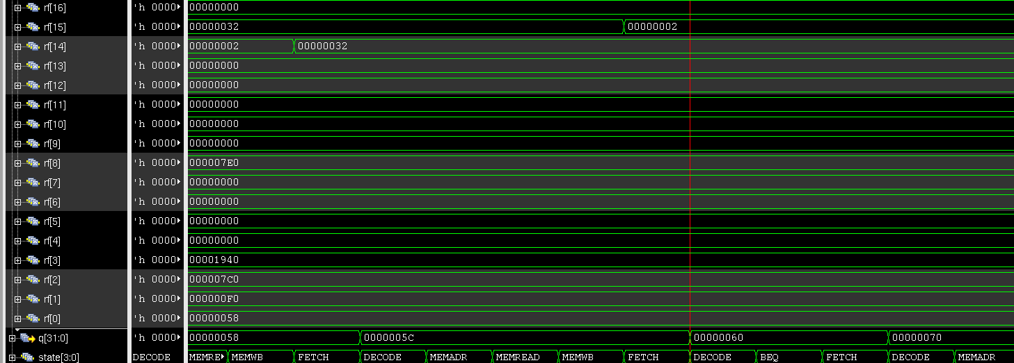
Analogy of Given Code: Different Instruction Description (Contd..)
60: bne a4,a5,70 <prime_number+0x58>
Example of Branch Taken
a5 and a4 are 16th and 15th Registers respectively

Slide 46
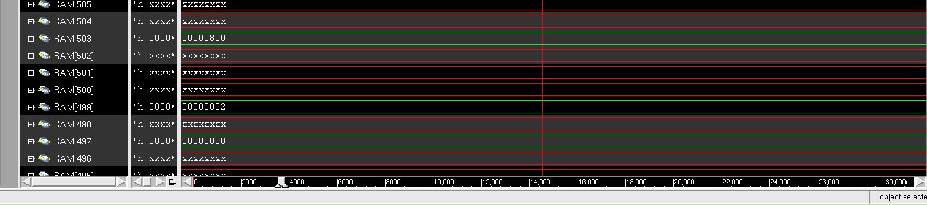
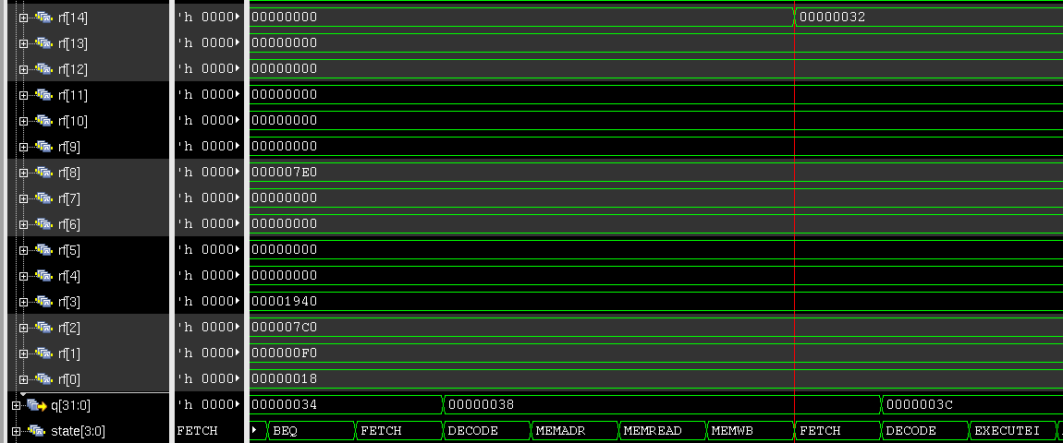
Analogy of Given Code: Different Instruction Description (Contd..)
38: lw a4,-20(s0)
s0 is 9th Register
a4 is 15th Register

Slide 47
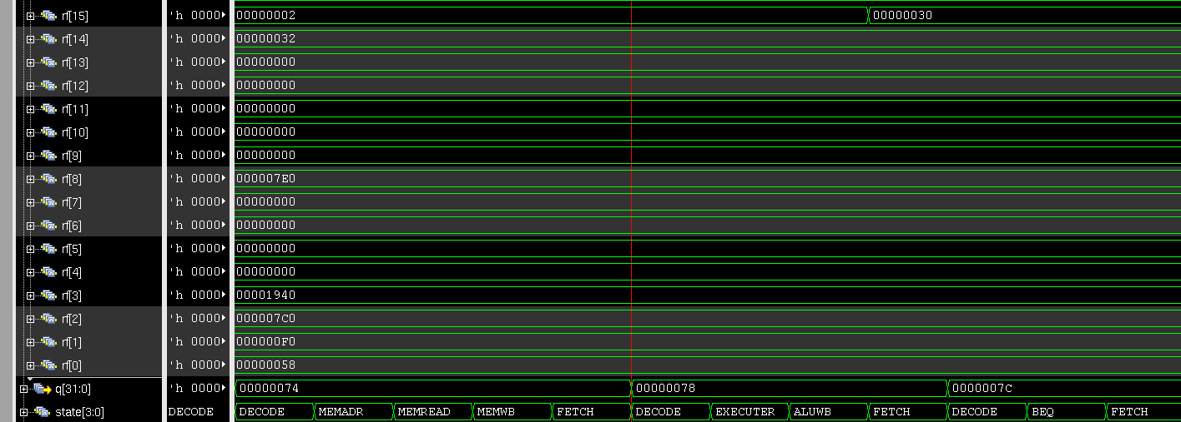
Analogy of Given Code: Different Instruction Description (Contd..)
90: sub a5,a4,a5
a4 is 15th Register
a5 is 16th Register

Slide 48
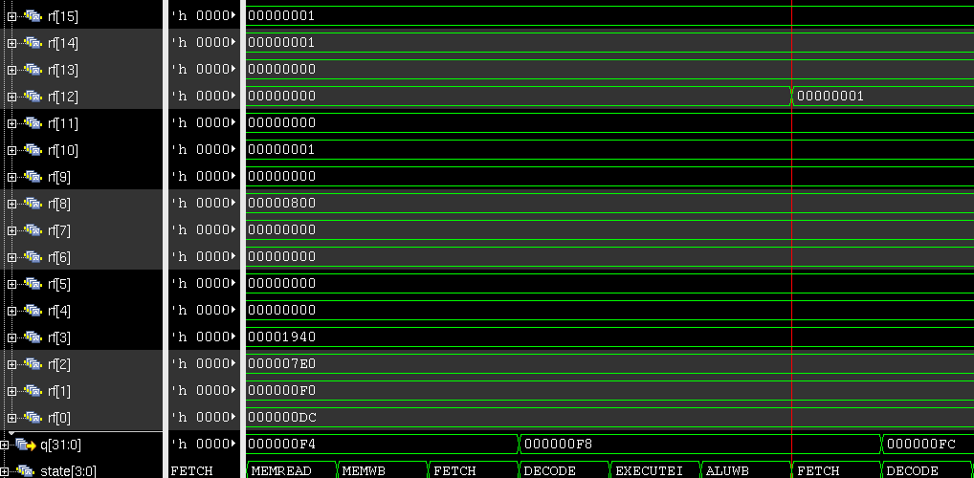
Analogy of Given Code: Different Instruction Description (Contd..)
f8: mv a2,a5
a2 is 13th Register
a5 is 16th Register

Slide 49
A Small New Code with Other Instructions
Explanation:
x2=5
x3=5
x3>[x2+20]
x5=5
x6=8
addi x2 x0 5
addi x3 x0 5
sw x3 20(x2)
nop
or x5 x2 x3
andi x6 x5 5

Slide 50
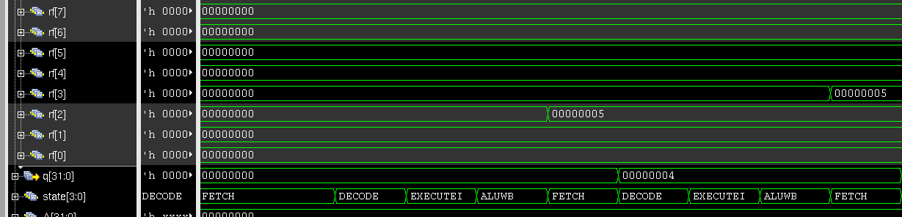
A Small New Code with Other Instructions: Simulated Output
First Two Addi Operation

Slide 51
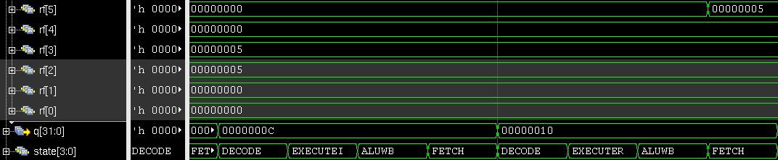
A Small New Code with Other Instructions: Simulated Output
NOP operation and OR operation

Slide 52

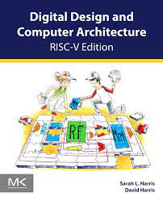
Acknowledgement
Special thanks to Sarah-Harris, our whole endeavor is inspired from Digital Design and Computer Architecture, RISC-V Edition: RISC-V Edition, chapter 7 exercise
Also we are grateful to Dr. A.B.M. Harun-Ur-Rashid Sir, Mumtahina Islam Sukanya madam and the members of NSL team for their constant support and guidance .

Slide 53
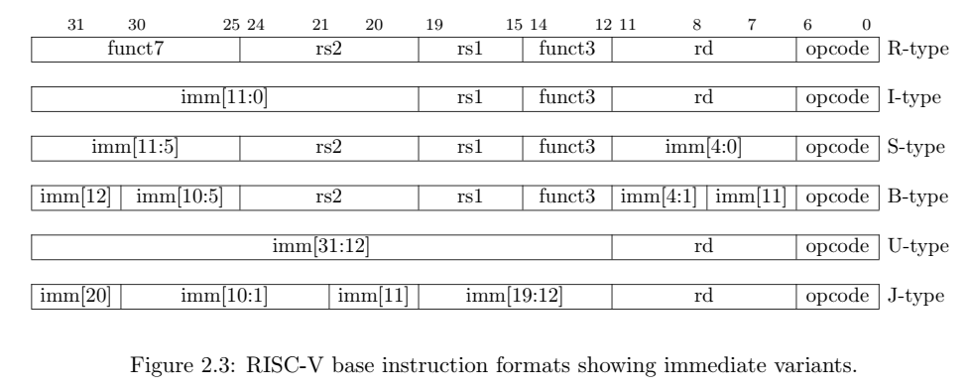
References
Instruction Formats:

Slide 54
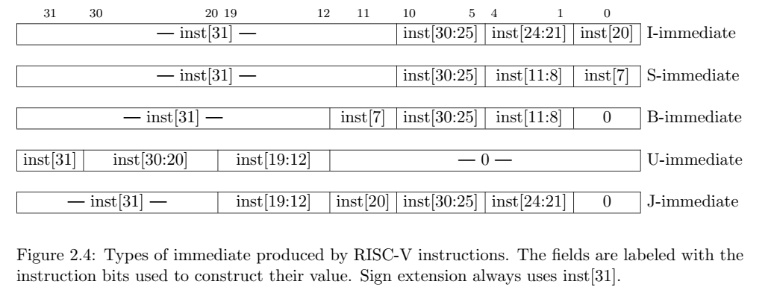
References
Immediate Formats:

Slide 55
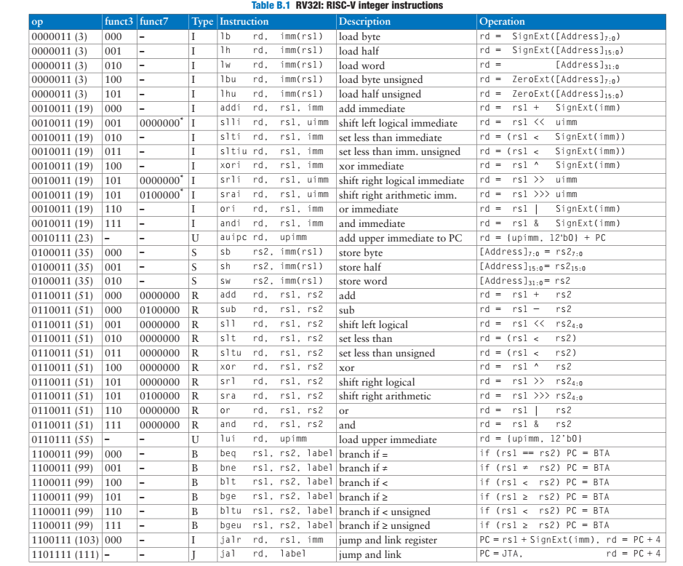
References-Instruction Sets:

Slide 56
Thank You

